Slide 1


Superstore Sales Data Analysis
An End-to-End Data Analytics Project
Presented By:
Mohammed Abdelrahman
Mohammed Mahmoud
Supervised By:
Eng. Ahmed Samir

Slide 2

Agenda
Project Overview & Dataset
1
Data Cleaning and Normalization
2
3
Exploratory Data Analysis (EDA)
4
Data Visualization (Tableau Dashboard)
5
Recommendations & Conclusion

Slide 3

Phase 1: Project Overview & Dataset
Project Objective
Our primary objective is to analyze sales and shipping data from a superstore to identify key trends, inefficiencies, and opportunities for optimizing business operations.
Methodology
We adopted a robust, structured pipeline to ensure data quality and derive meaningful insights:
Data Cleaning (Excel)
Data Wrangling (Python)
Database Normalization
Exploratory Data Analysis
Visualization & Reporting
Tools Utilized
A powerful combination of industry-standard tools:
Microsoft Excel for initial data hygiene
Python (Pandas, NumPy) for advanced manipulation
Tableau for dynamic dashboards and visualizations

Slide 4

Understanding the Superstore Sales Dataset
Dataset Description
Our analysis begins with a comprehensive dataset containing detailed sales information:
Source: Raw CSV file named "Superstore Sales.csv".
Dimensions: A substantial dataset comprising 9,800 rows and 18 columns, offering a rich basis for analysis.
Key Columns for Analysis
These columns form the backbone of our investigation:
Order ID: Unique identifier for each order.
Order Date: When the order was placed.
Ship Date: When the order was shipped.
Ship Mode: Method of shipment (e.g., Standard Class, First Class).
Customer ID: Unique identifier for each customer.
Segment: Customer segment (e.g., Consumer, Corporate, Home Office).
Country & City: Geographical location of the customer.
Product ID: Unique identifier for each product.
Sales: Revenue generated from the product.

Slide 5

Phase 2: Data Cleaning with Excel
Step 1: Handling Duplicate Records
Data integrity starts with uniqueness. Our initial step focused on identifying and eliminating redundant entries.
Inspection: We meticulously reviewed the entire dataset within Excel to locate any identical rows that could skew our analysis.
Action: The built-in "Remove Duplicates" function in Excel was applied systematically across all columns to ensure absolute data uniqueness.
Result: A thorough check confirmed zero duplicate records, affirming the integrity of our dataset for subsequent phases.

Slide 6

Phase 2: Data Cleaning with Excel
Step 2: Addressing Missing Values
Missing data can introduce noise and inaccuracies. We strategically handled incomplete information to refine our dataset.
Issue Identified: Our audit revealed 11 missing values exclusively within the "Postal Code" column.
Contextual Analysis: After careful consideration, we determined that the "Postal Code" field was largely redundant. Essential location data was already robustly provided by the City, State, and Region fields.
Decisive Action: To reduce unnecessary noise and streamline the dataset, the "Postal Code" column was entirely removed, focusing our data on more impactful geographical dimensions.

Slide 7



Phase 2: Data Cleaning with Excel
Step 3: Ensuring Logical Data Validation
Objective
Key Checks Performed
Outcome
The goal of logical validation is to ensure that the relationships and temporal sequences within the data make intuitive and practical sense, preventing contradictions like a product shipping before it's ordered.
Verified consistency between Order ID and Customer ID, ensuring each order is correctly attributed to a customer.
All logical checks passed successfully, confirming robust consistency across date fields and relational identifiers. This guarantees the data's reliability for deeper analysis.
Validated the association between Product ID and Category, confirming products are accurately categorized.
Crucially, we checked that Ship Date always occurs after Order Date, eliminating any illogical temporal sequences.

Slide 8

Phase 2: Advanced Data Wrangling with Python
Setup & Environment
Our advanced data wrangling leveraged Python's powerful libraries:
Libraries: We imported Pandas for its robust data manipulation capabilities and NumPy for efficient numerical operations.
Loading: The cleaned dataset from Excel was loaded into a Pandas DataFrame, serving as the foundation for sophisticated processing.
Why Python?
Python was chosen for its ability to handle complex transformations and intricate data cleaning tasks that are challenging or impossible to execute efficiently within Excel. It provides greater automation and scalability.

Slide 9




Python: Time-Series Preparation & Feature Engineering
Date Type Conversion
Initially, "Order Date" and "Ship Date" were generic strings. We used pd.to_datetime with dayfirst=True to convert them, ensuring accurate time-series analysis.
Creating Shipping Duration
A critical new feature, shipping_duration_days, was engineered by calculating the difference between "Ship Date" and "Order Date".
Enabling Trend Analysis
These steps enable us to analyze shipping efficiency, identify logistical bottlenecks, and understand seasonal sales trends with greater precision.

Slide 10
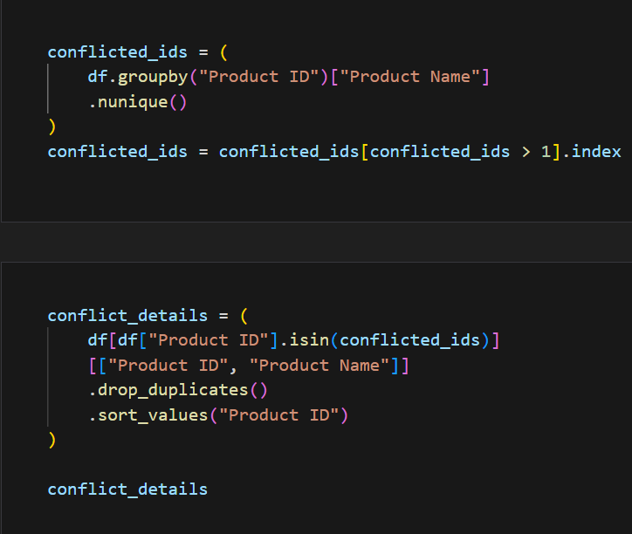
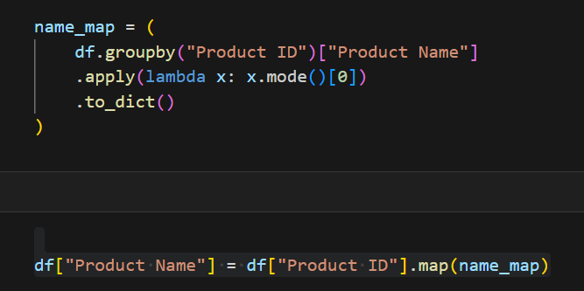
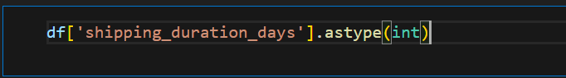
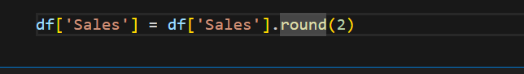
Python: Data Integrity & Optimization
Resolving Product Conflicts
We encountered an issue where a single Product ID was inconsistently associated with multiple Product Names.
Solution: A mapping dictionary was created to assign the most frequently occurring (mode) Product Name to its corresponding Product ID.
Outcome: This process standardized product names, ensuring accurate aggregation and analysis of sales data, eliminating ambiguity.
Final Data Polish
Before moving forward, we applied several optimization steps:
Type Conversion: Converted shipping_duration_days to an integer type for memory efficiency.
Rounding: Rounded the Sales column to two decimal places to meet financial reporting standards.
Standardization: Renamed all columns to lowercase with underscores (e.g., ship_mode) for coding consistency and easier accessibility.

Slide 11
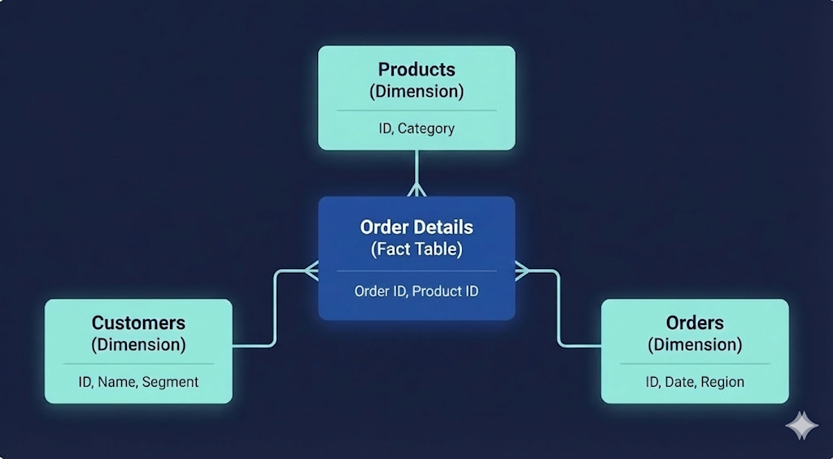
Phase 2 :Database Normalization
Converted the original flat Superstore dataset into a Relational Star Schema to improve structure and consistency.
Designed 4 core dimension and fact tables:
Customers Table – Stores unique customer profiles to avoid duplication.
Products Table – Standardizes product information and categories.
Orders Table – Captures high-level order information (date, segment, region).
Order Details Table – Fact table linking Orders with Products to track Sales.
Technical Optimization:
Data Integrity: Enforced Referential Integrity to prevent "orphan records" and logical errors.
Efficiency: Reduced storage footprint and optimized the dataset for faster query performance and seamless joining in Tableau.

Slide 12





Phase 3:Exploratory Data Analysis (EDA) Insights
Sales Trends & Seasonality:
Analysis reveals a consistent sales growth in the second half of the year, peaking significantly in Q4 (Nov & Dec).
Customer Segmentation:
The Consumer segment is the top contributor, accounting for 51% of total sales, outperforming Corporate and Home Office segments.
Regional Performance:
The West Region leads in sales volume with 32% market share, followed closely by the East Region (30%).
Logistics & Shipping Analysis:
Standard Class is the dominant shipping mode (59.3% of orders), though it has a longer shipping duration compared to other modes.
The overall Average Shipping Time is maintained at 4 Days, ensuring operational efficiency.
Product Performance:
Phones and Chairs were identified as the top-selling products, generating the highest revenue volume across all categories.

Slide 13
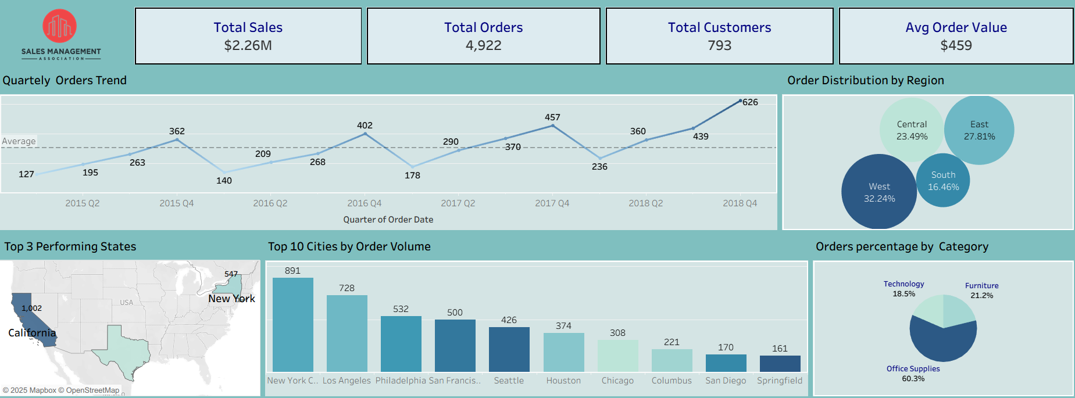
Phase 4: Overview Dashboard
Key Insights:
Steady Growth: Orders trended upward, peaking at 626 orders in Q4 2018.
Top Region: The West Region leads the market with 32.24% of total orders.
Key Locations: California is the top state (1,002 orders), while New York City leads among cities.
Volume Driver: Office Supplies account for 60.3% of transactions.
Customer Metrics: Generated 4,922 orders with an average value of $459.

Slide 14
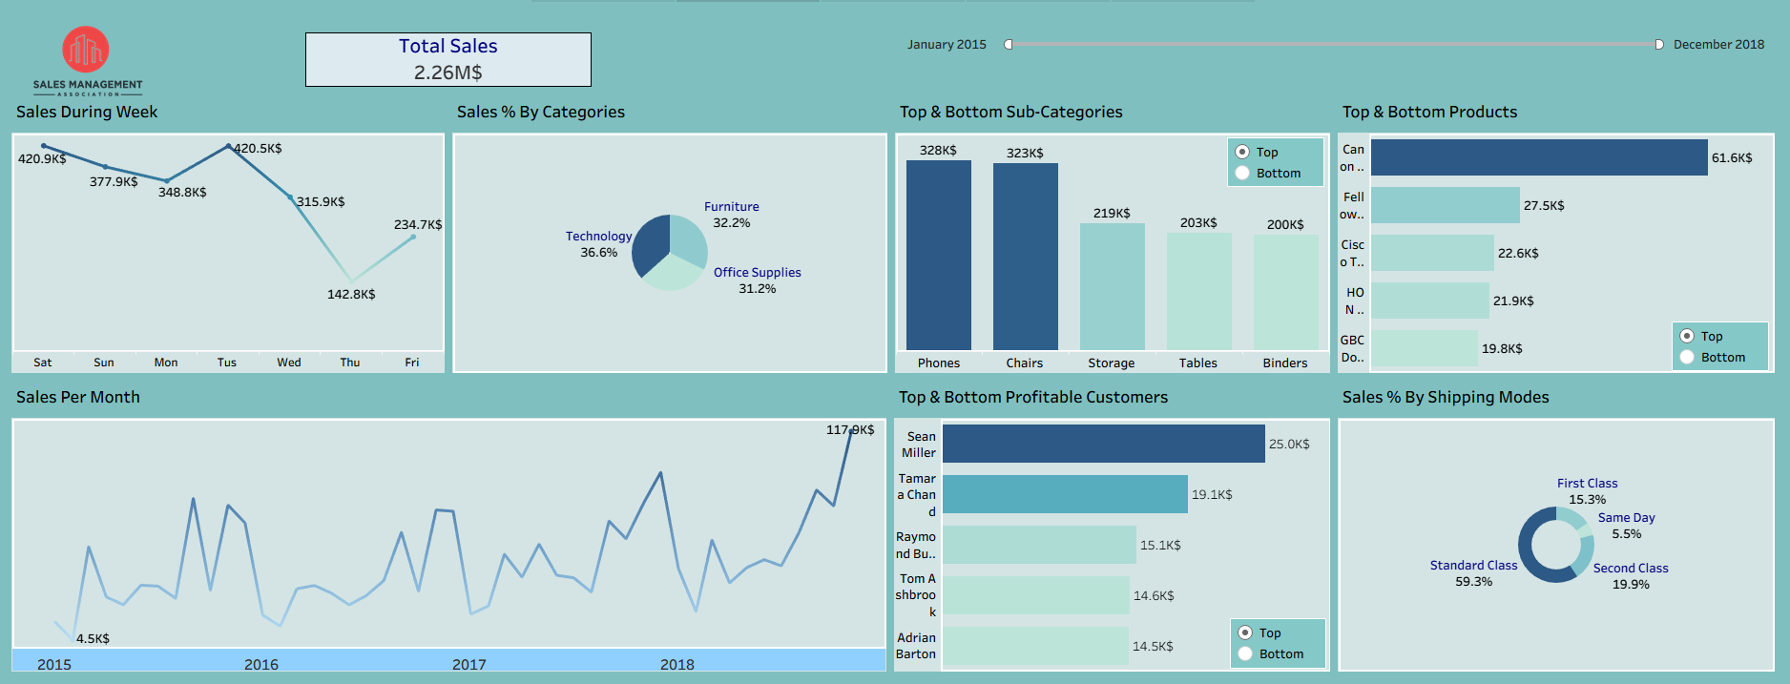
Sales Performance Dashboard
Key Insights:
Total Revenue: Achieved 2.26M in total sales across all regions.
Top Segment: The Consumer segment is the market leader, contributing 51% of total revenue.
Regional Focus: The West Region outperforms others, capturing 32% of the market share.
Shipping Preference: Standard Class is the dominant choice, selected in 60% of orders (as seen in the chart).
Seasonal Trend: Monthly analysis shows a significant sales spike in Q4, driven by year-end demand.

Slide 15
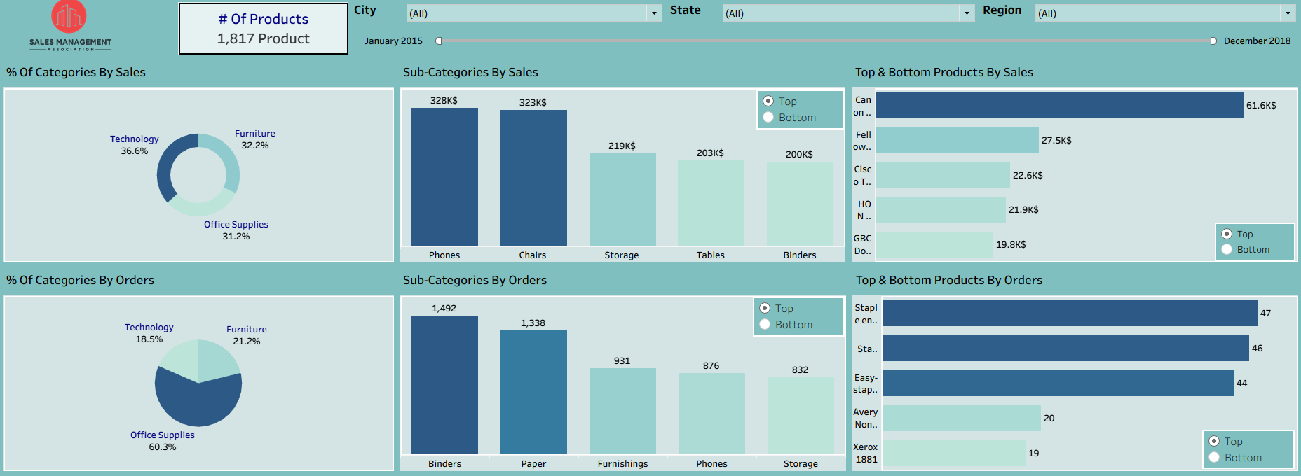
Products Spotlight Dashboard
Key Insights:
Product Portfolio: The catalog consists of 1,817 active products.
Revenue vs. Volume: Technology generates the most revenue (36.6%), while Office Supplies dominate volume (60.3%).
Top Sub-Categories: Phones and Chairs are the highest revenue earners (over $320K each).
High Frequency: Binders are the most frequently purchased items (1,492 orders).
Star Product: The Canon imageCLASS Copier is the top-selling individual product ($61.6K).

Slide 16
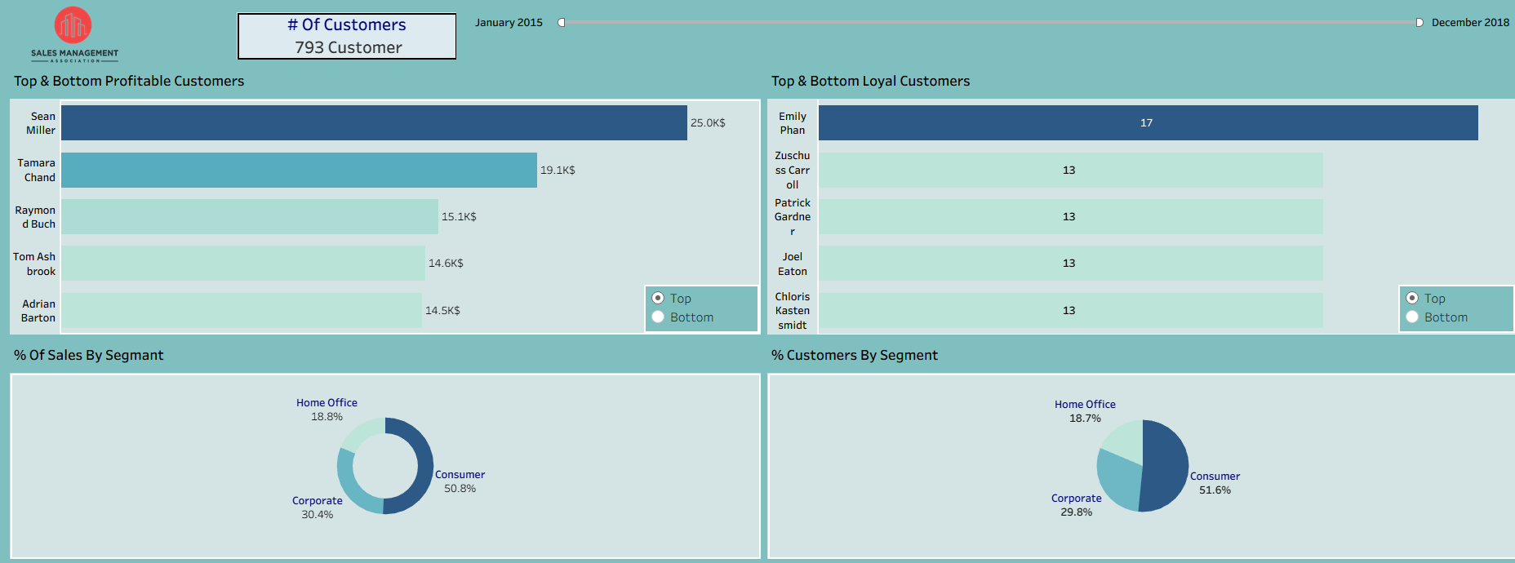
Customers Demand Dashboard
Key Insights:
Customer Base: Successfully served 793 active customers across all segments.
Top Spender: Sean Miller represents the highest revenue with $25.0K.
Most Loyal: Emily Phan leads in frequency, placing 17 orders.
Key Segment: The Consumer segment drives the market, holding 51% of sales.
Spending Habit: Revenue distribution aligns consistently with the number of customers.

Slide 17
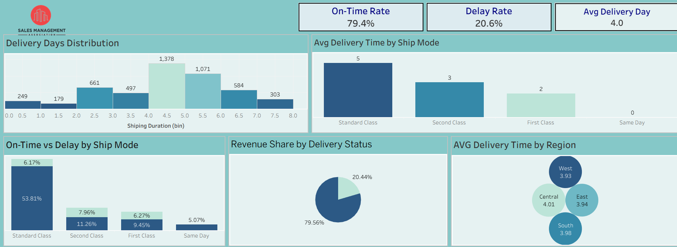
Delivery Dashboard
Key Insights:
Efficiency: Achieved a 79.4% On-Time Rate for all deliveries.
Speed: Average delivery time is 4 days across the board.
Shipping Modes: Standard Class is the slowest (5 days) yet most used.
Revenue Impact: Delayed orders impact 20.4% of total revenue.
Consistency: Delivery performance is stable across all 4 regions

Slide 18
Phase 4: Recommendations & Conclusion
1. Strategic Focus on High-Yield Products
Target: Prioritize Technology products (specifically Phones & Copiers).
Rationale: They drive the highest profit margins, despite lower volumes compared to Office Supplies.
2. Optimize Logistics Operations
Problem: Standard Class shipping causes the majority of the 20.6% delay rate.
Action: Negotiate better terms or adjust delivery promises to recover revenue.
3. Customer Retention Strategy
Consumer Segment (51%): Launch loyalty programs to maintain dominance.
Home Office: Create B2B incentives to boost this segment's share.
4. Regional Expansion Model
Benchmark: Analyze operational success in California (Top State).
Action: Replicate supply chain & sales strategies in underperforming regions like the South.

Slide 19
Thank You
Any Questions?
Prepared by:
Mohammed Abdelrahman
Mohammed Mahmoud:
Special Thanks to :
Eng. Ahmed Samir

